Slide 1
MGB235 Monitoring and Managing Operational Performance
Week 8 Supply Chain Management: Strategy & Design
Global supply chain procurement & distribution
Chapter 15:
Stevenson, W.J. (2021) 14th ed. Operations Management, McGraw Hill, New York, NY.
Chapters 10 & 11
Russell, Roberta S., and Taylor III, Bernard W. (2017) Operations management:
Creating value along the supply chain, 9th ed., Hoboken, NJ.
Fitzsimmons and Fitzsimmons, Chapter 15 (QUT Readings)

Slide 2
Lecture Outline
Supply Chain – Value Chain – Global Supply Chain
The Management of Supply Chains
Green Supply Chains
Information Technology: A Supply Chain Enabler
Procurement & E-Procurement
Distribution
Transportation
The Global Supply Chain

Slide 3
Supply Chains
The facilities, functions, and activities involved in producing and delivering a product or service from suppliers to customers
An integrated group of processes to “source,” “make,” and “deliver” products
Logistics:
The part of a supply chain involved with the forward and reverse flow of goods, services, cash, and information.

Slide 4
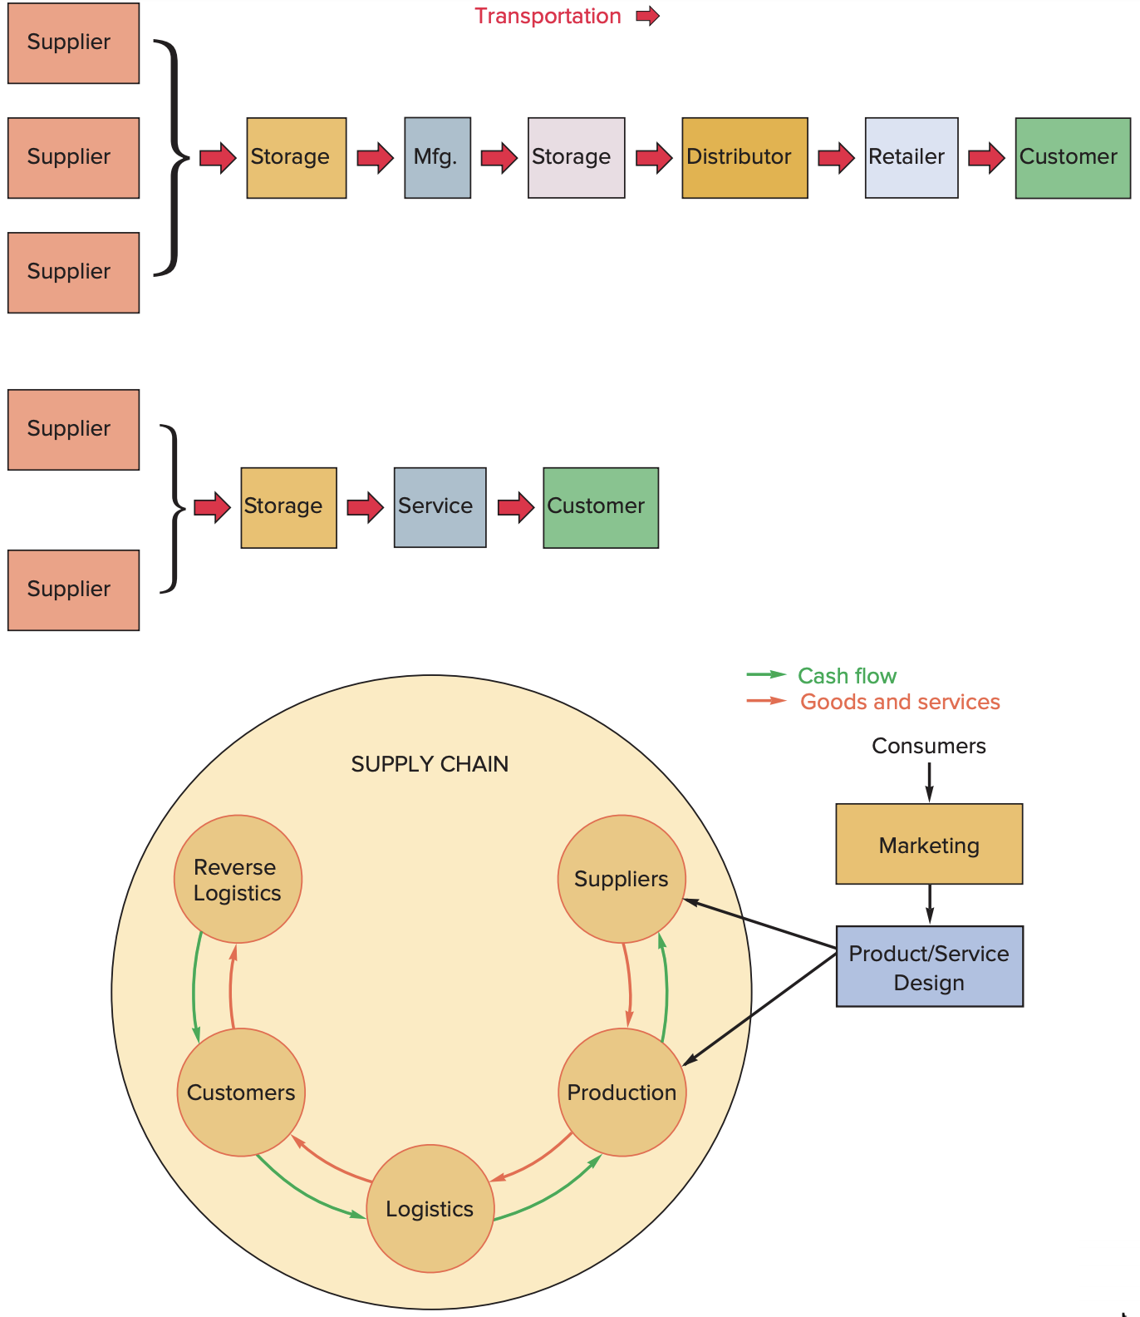
Typical Supply Chains
Copyright ©2021 McGraw-Hill Education. All rights reserved. No reproduction or distribution without the prior written consent of McGraw-Hill Education.
15-4

Slide 5
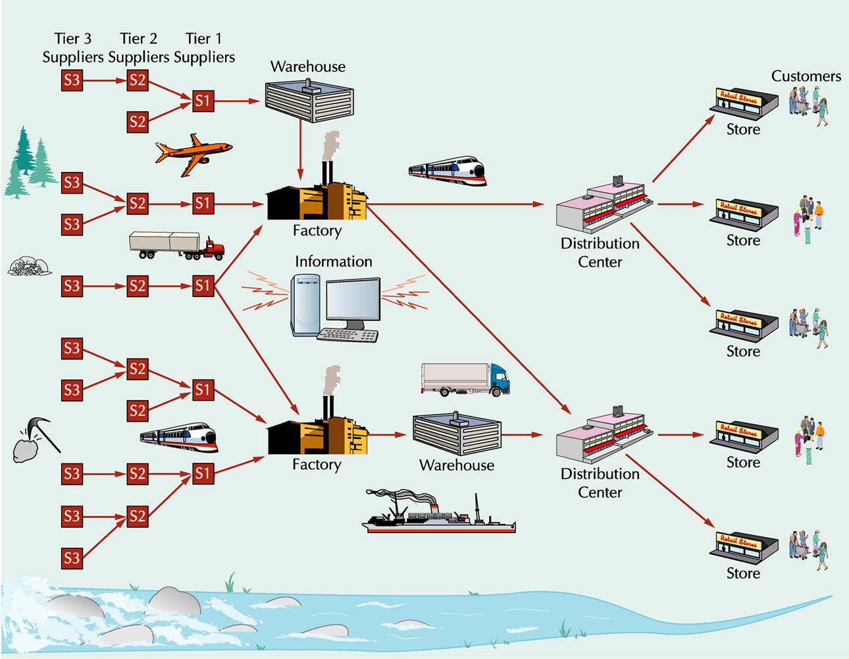
Supply Chain Structure

Slide 6
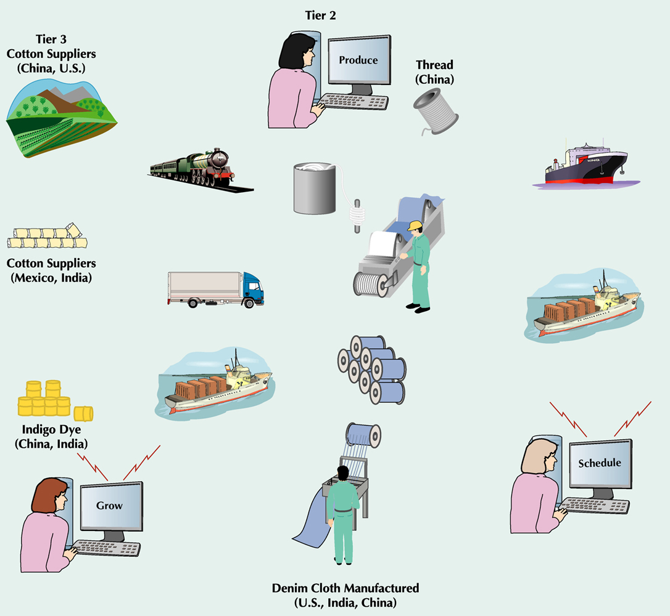
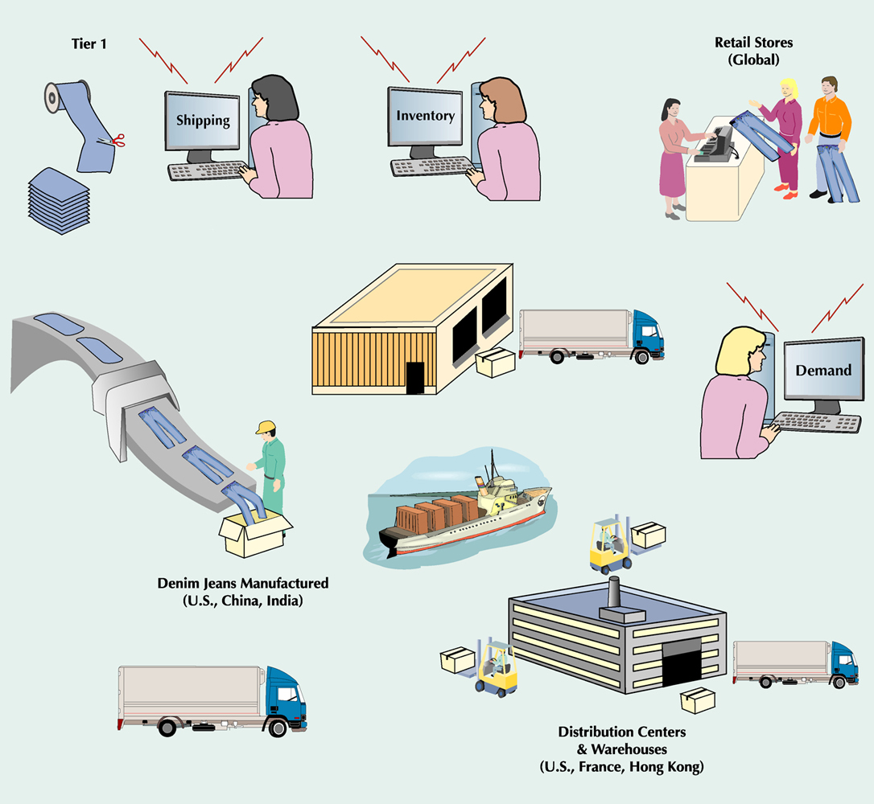
E.G. Global Supply Chain for Denim Jeans

Slide 7
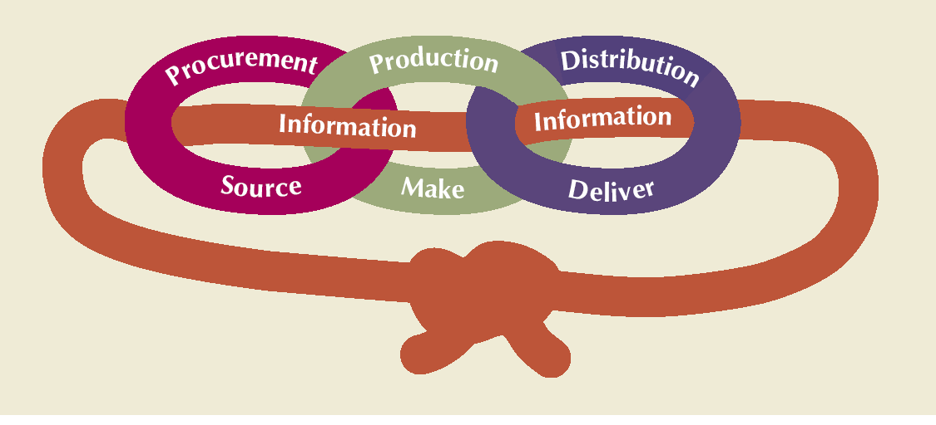
Supply Chain Processes

Slide 8
Supply Chains for Service Providers
More difficult than manufacturing
Does not focus on the flow of physical goods
Focuses on human resources and support services
More compact and less extended

Slide 9
The value chain
The value chain describes the categories of activities within an organisation, which, together, create a product or service.
The value chain consists of five primary activities (which are directly concerned with the creation or delivery of a product or service) and four support activities (which help to improve the effectiveness or efficiency of primary activities).
Competitive advantage can be analysed in any of these activities.

Slide 10
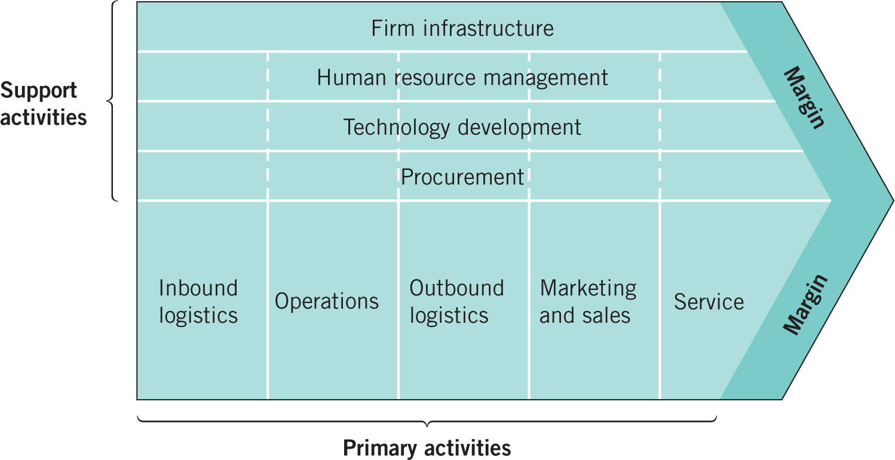
The value chain
Source: Adapted with the permission of The Free Press, a Division of Simon & Schuster, Inc., from Competitive Advantage:
Creating and Sustaining Superior Performance by Michael E. Porter. Copyright © 1985, 1998 by Michael E. Porter. All rights reserved.
Copyright © 2020, 2017, 2014 Pearson Education, Inc. All Rights Reserved
Notes:
Figure 4.4 The value chain within an organisation

Slide 11
Value Chains
Value chain
Broader than supply chain
Customer management
New product innovation
Post-sales support
Change management
Demand-driven value chain
Supply management
Demand management
Product management

Slide 12
Supply Chain Management (SCM)
The strategic coordination of business functions within a business organization and throughout its supply chain for the purpose of integrating supply and demand management (Stevenson, 2021)
Managing flow of information through supply chain in order to attain the level of synchronization that will make it more responsive to customer needs while lowering costs
Keys to effective SCM
information
communication
cooperation
Trust

Slide 13
Supply Chain Uncertainty and Inventory
A major objective of SCM:
respond to uncertainty in customer demand without creating costly excess inventory
Negative effects of uncertainty
lateness
incomplete orders
Inventory
insurance against supply chain uncertainty

Slide 14
Supply Chain Uncertainty and Inventory
Factors that contribute to uncertainty
inaccurate demand forecasting
long variable lead times
late deliveries
incomplete shipments
product changes
batch ordering
price fluctuations and discounts
inflated orders

Slide 15
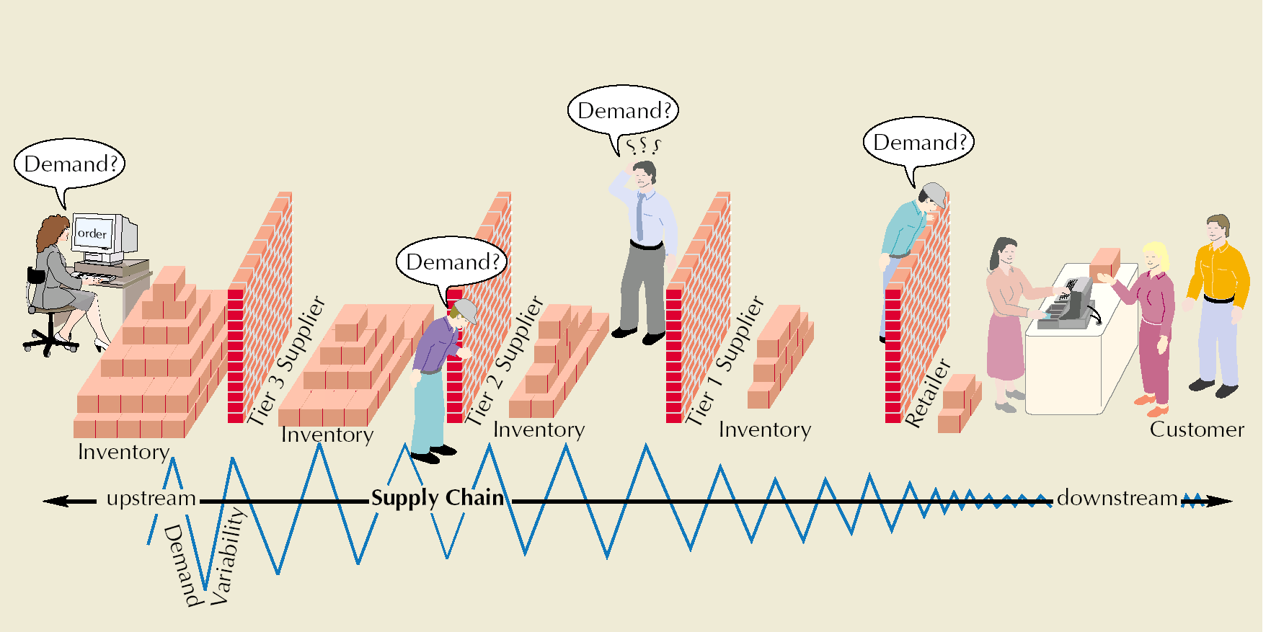
Bullwhip Effect
Occurs when slight demand variability is magnified as information moves back upstream
Information

Slide 16
Supply Chain Risks
Supply chain risks
Supply chain disruption
Natural disasters
Supplier problems
Quality issues
Another form of disruption that may disrupt supplies and lead to product recalls, liability claims, and negative publicity
Loss of control of sensitive information
If suppliers divulge sensitive information to competitors, it can weaken a firm’s competitive position
Copyright ©2021 McGraw-Hill Education. All rights reserved. No reproduction or distribution without the prior written consent of McGraw-Hill Education.
15-16

Slide 17
Risk Management
Risk management
Involves identifying risks, assessing their likelihood of occurring and their potential impact and then developing strategies for addressing those risks
Strategies for addressing risk include:
Risk avoidance
Risk reduction
Risk sharing
Key elements of successful risk management include:
Know your suppliers
Provide supply chain visibility
Develop event-response capability
Copyright ©2021 McGraw-Hill Education. All rights reserved. No reproduction or distribution without the prior written consent of McGraw-Hill Education.
15-17

Slide 18
Supply Chain Sustainability
“Going green”
Meeting present needs without compromising the ability of future generations to meet their needs
Sustaining human and social resources
It can be cost effective and profitable
Can provide impetus for product and process innovations
Impetus comes from downstream in the supply chain and moves upstream to suppliers
Copyright ©2017 John Wiley & Sons, Inc

Slide 19
SCM Ethical Issues
Examples:
Bribing government or company officials to secure permits or favorable status
“Exporting smokestacks” to developing countries
Claiming a “green” supply chain when the level of “green” is only minimal
Ignoring health, safety, and environmental standards
Violating basic worker rights
Mislabeling the country of origin
Selling products abroad that are banned at home
Dealing with ethical issues:
Develop an ethical supply chain code of behavior
Monitor supply chain activities
Choose suppliers that have a reputation for good ethical behavior
Incorporate compliance with labor standards in supplier contracts
Address any ethical problems that arise swiftly
Copyright ©2021 McGraw-Hill Education. All rights reserved. No reproduction or distribution without the prior written consent of McGraw-Hill Education.
15-19

Slide 20
Sustainability and Quality Management
Reducing waste through quality programs helps achieve sustainability goals
Improving fuel efficiency of vehicles
Telecommuting
Eco-friendly packing materials
Energy-efficient facilities
Changing thermostat settings

Slide 21

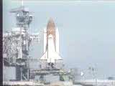
Quality Management in the Supply Chain
Challenger Disaster
Source: http://www.nasa.gov/mission_pages/shuttle/shuttlemissions/archives/sts-51L.html
10.21

Slide 22
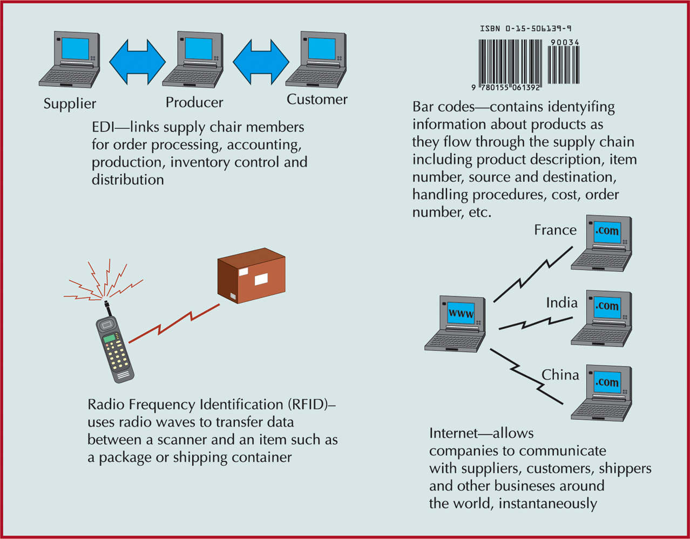
IT: Supply Chain Enabler
10-22

Slide 23
E-Business & Supply Chain Management
Savings due to lower transaction costs
Reduction of intermediary roles
Shorter supply chain response times
Wider presence and increased visibility
Greater choices & more info for customers
Improved service
Collection & analysis of huge amounts of customer data & preferences
Access to global markets, suppliers & distribution channels

Slide 24
SCM Software
Enterprise resource planning (ERP)
software that integrates the components of a company by sharing and organizing information and data
Collaborative Planning, Forecasting, and Replenishment (CPFR)
Two or more companies in a supply chain to synchronize their demand forecasts into a single plan to meet customer demand
Parties electronically exchange
past sales trends
point-of-sale data
on-hand inventory
scheduled promotions
forecasts

Slide 25
Measuring Supply Chain Performance
Metrics used to measure supply chain performance
Inventory turnover
Total value (at cost) of inventory

Slide 26
Measuring Supply Chain Performance
Days of supply
Fill rate: fraction of orders filled by a distribution center within a specific time period

Slide 27
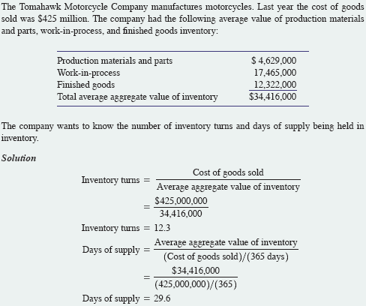
e.g. Computing Key Performance Indicators

Slide 28
Process Control and SCOR
Process Control
not only for manufacturing operations
can be used in any processes of supply chain
Supply Chain Operations Reference (SCOR)
a cross industry supply chain diagnostic tool maintained by the Supply Chain Council

Slide 29
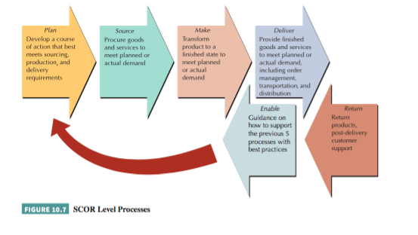
SCOR Level Processes

Slide 30
SCOR Performance Metrics

Slide 31
Procurement
The purchase of goods and services from suppliers
On-demand (direct-response) delivery
requires the supplier to deliver goods when demanded by the customer
Continuous replenishment
supplying orders in a short period of time according to a predetermined schedule
Cross enterprise teams
coordinate processes between a company and its supplier
Supply Chain Integration

Slide 32
Procurement & Supply Chain Design
A push system produces goods in advance of customer demand using a forecast of sales and moves them through supply chain to points of sale where they are stored as finished goods inventory.
A pull system produces only what is needed at upstream stages in the supply chain in response to customer demand signals from downstream stages.
32

Slide 33
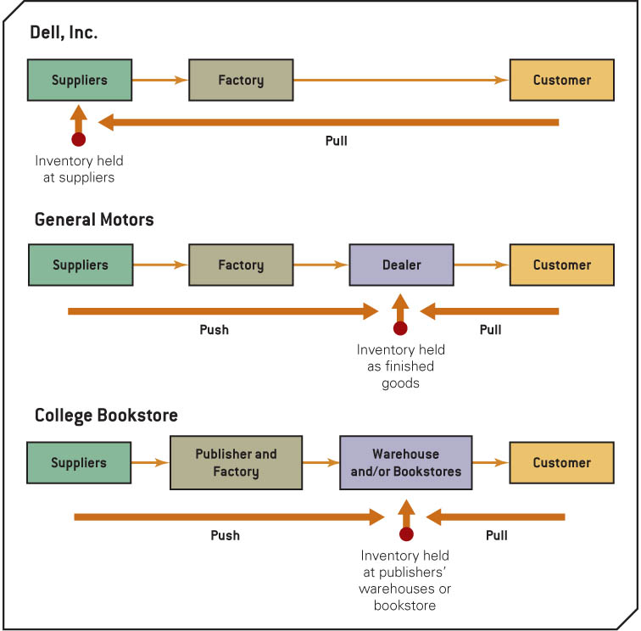
Push and Pull Systems
33

Slide 34
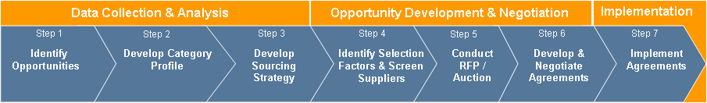
Procurement Strategy in designing the supply chain
Effective procurement strategy supports an efficient supply chain design
Decisions made in ‘how we buy’ critical to supply chain efficiency and success
Strategic Sourcing Methodology
34

Slide 35
E-Procurement
Direct purchase from suppliers over the Internet, by using software packages or through e-marketplaces, e-hubs, and trading exchanges
Can streamline and speed up the purchase order and transaction process
What can companies buy over the Internet?
Manufacturing inputs
the raw materials and components that go directly into the production process of the product
Operating inputs
maintenance, repair, and operation goods and services
E-marketplaces (e-hubs)
Websites where companies and suppliers conduct business-to-business activities
Reverse auction
process used by e-marketplaces for buyers to purchase items; company posts orders on the internet for suppliers to bid on

Slide 36
Distribution
Encompasses all channels, processes, and functions, including warehousing and transportation, that a product passes on its way to final customer
Order fulfillment
process of ensuring on-time delivery of an order
Logistics
transportation and distribution of goods and services
Driving force today is speed
Particularly important for Internet dot-coms

Slide 37
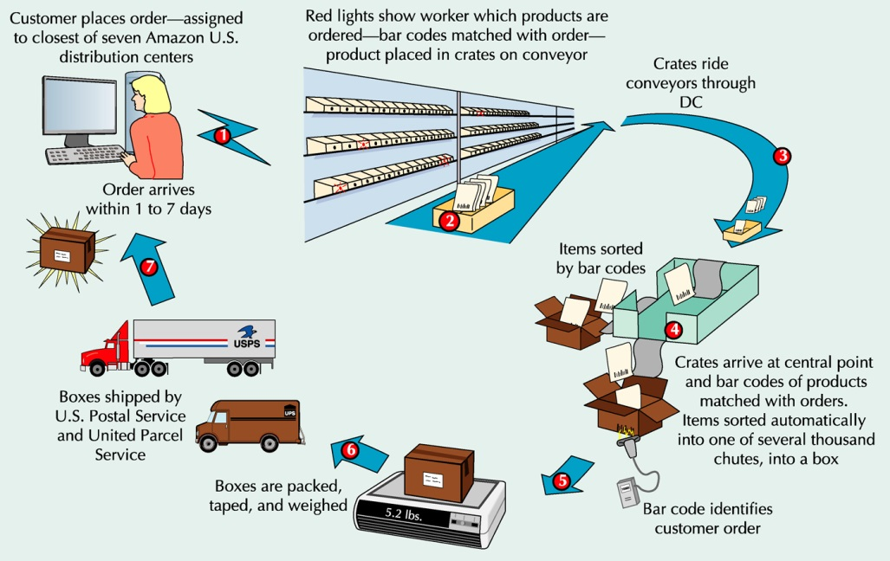
Order Fulfillment at Amazon.com

Slide 38
Warehouse Management Systems
Highly automated system that runs day-to-day operations of a Distribution Centre
Controls item putaway, picking, packing, and shipping
Features
transportation management
order management
yard management
labor management
warehouse optimization
Inventory management

Slide 39
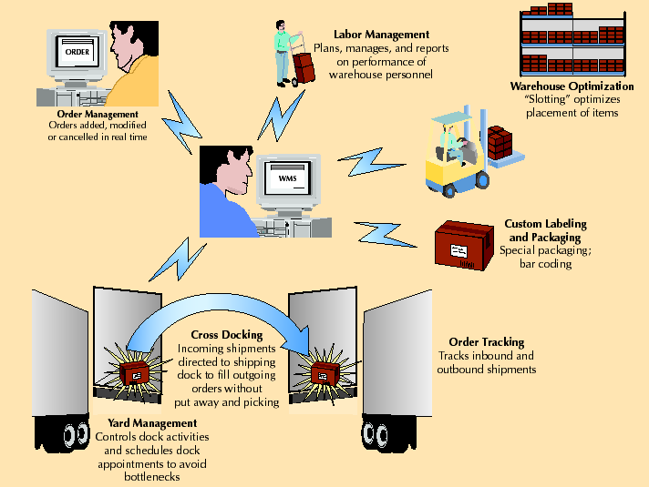
A WMS

Slide 40
Vendor-Managed Inventory
SMI – Supplier Managed Inventory
Manufacturers, rather than vendors, generate orders
Stocking information is accessed using EDI
A first step towards supply chain collaboration
Increased speed, reduced errors, and improved service
Copyright ©2017 John Wiley & Sons, Inc.

Slide 41
Collaborative Logistics and Distribution Outsourcing
Collaborative planning, forecasting, and replenishment create greater economies of scale
Internet-based exchange of data and information
Significant decrease in inventory levels and costs and more efficient logistics
Companies focus on core competencies

Slide 42
Transportation
Rail
low-value, high-density, bulk products, raw materials, intermodal containers
not as economical for small loads, slower, less flexible than trucking
Trucking
main mode of freight transport in U.S.
small loads, point-to-point service, flexible
More reliable, less damage than rails; more expensive than rails for long distance
Air
most expensive and fastest mode of freight transport
lightweight, small packages <500 lbs
high-value, perishable and critical goods
less theft
Package carriers
small packages
fast and reliable
increased with e-Business
primary shipping mode for Internet companies
Copyright ©2017 John Wiley & Sons, Inc.

Slide 43
Transportation
Water
low-cost yet slowest shipping mode
primary means of international shipping
U.S. waterways
Intermodal
combines several modes of shipping: truck, water and rail
key component is containers
Pipeline
transport oil and products in liquid form
high capital cost, economical use
long life and low operating cost
Copyright ©2017 John Wiley & Sons, Inc.

Slide 44
Internet Transportation Exchanges
Bring together shippers and carriers
Initial contact, negotiations, auctions
Examples
www.freightquote.com

Slide 45
Global Supply Chains
Global supply chains
Product design often uses inputs from around the world
Some manufacturing and service activities are outsourced to countries where labor and/or materials costs are lower
Products are sold globally
Complexities
Language and cultural differences
Currency fluctuations
Political instability
Increasing transportation costs and lead times
Increased need for trust amongst supply chain partners
Copyright ©2021 McGraw-Hill Education. All rights reserved. No reproduction or distribution without the prior written consent of McGraw-Hill Education.
15-45

Slide 46
Obstacles to Global Chain Transactions
Increased documentation for invoices, cargo insurance, letters of credit, ocean bills of lading or air waybills, and inspections
Ever-changing regulations that vary from country to country that govern the import and export of goods
Trade groups, tariffs, duties, and landing costs
Limited shipping modes
Differences in communication technology and availability

Slide 47
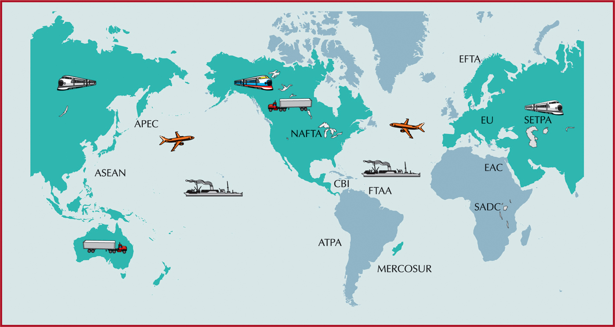
Duties and Tariffs

Slide 48
Web-based International Trade Logistic Systems
International trade logistics web-based software systems reduce obstacles to global trade
convert language and currency
provide information on tariffs, duties, and customs processes
attach appropriate weights, measurements, and unit prices to individual products ordered over the Web
incorporate transportation costs and conversion rates
calculate shipping costs online while a company enters an order
track global shipments

Slide 49
Small Business Concerns
Three small business SCM concerns:
Inventory management
Carry extra inventory as a way to avoid shortages due to supply chain interruption
Have backups for delivery from suppliers and to customers
Reducing risks
Use only reliable suppliers
Determine which suppliers are critical and get to know them and any challenges they have
Measure supplier performance
Recognize warning signs of supplier issues
Have plans in place to manage supply chain problems
International trade
Work with someone who has expertise to help oversee foreign suppliers
Set expectations for demand and timing
Do not rely on a single supplier
Build goodwill to help in negotiations and resolving any problem that arise
Consider using domestic suppliers if the risks of working with foreign suppliers are prohibitive
Copyright ©2021 McGraw-Hill Education. All rights reserved. No reproduction or distribution without the prior written consent of McGraw-Hill Education.
15-49

Slide 50
Summary
Supply chains are an integral part of the operations of a company
All supply chains have a supply and demand aspect
There is an increasing move to supply chain integration
Global supply chains are increasing in both frequency and size
Globalisation issues can impact heavily on supply chains

Slide 51
In the Lecture we covered:
Supply Chain – Value Chain
The Management of Supply Chains
Information Technology: A Supply Chain Enabler
Green Supply Chains
Measuring Supply Chain Performance
Global Supply Chain Procurement and Distribution
Procurement & E-Procurement
Distribution
Transportation
The Global Supply Chain

Slide 52
Week 9 Lecture: Forecasting (Please watch pre-recorded lecture on Canvas/Echo360 - No online or on campus lecture in Week 9)

